Slide 1
Asynchronous Domain Model in Javascript
Asynchronous Idioms Exploit Concurrency Asynchronous Domain Models
Miguel Gamboa @ ISEL

Slide 2
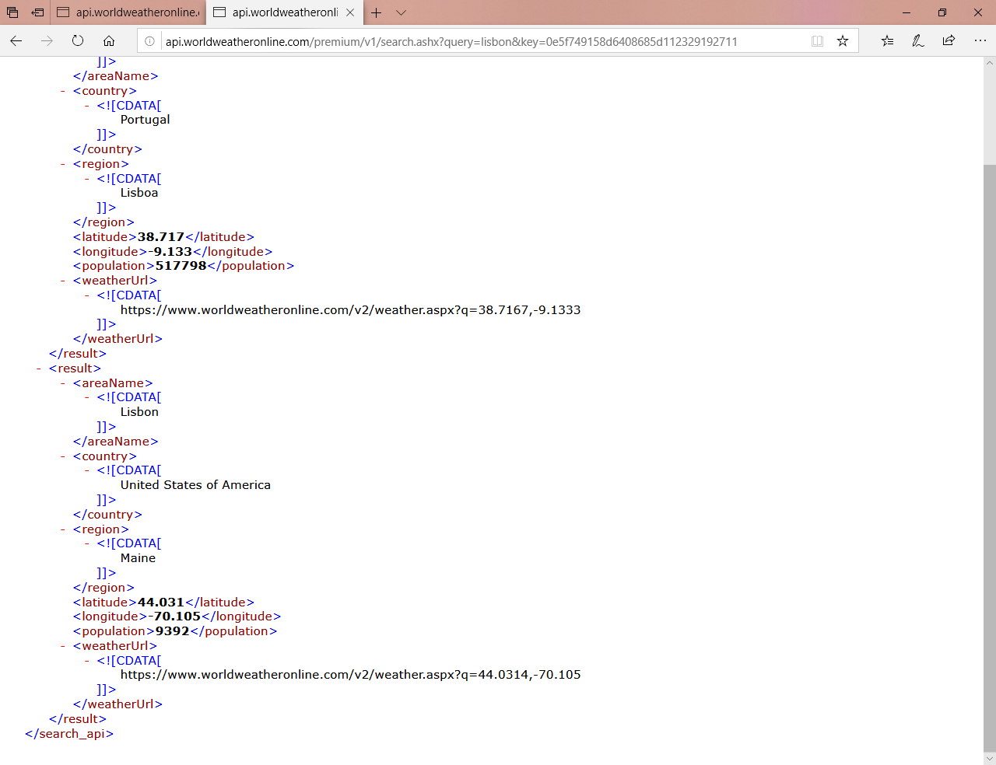
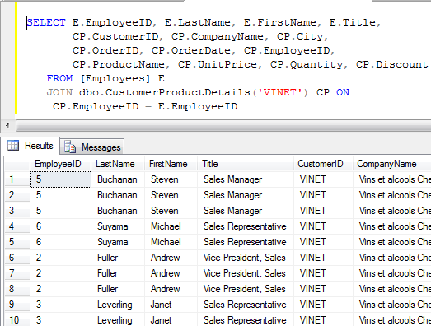
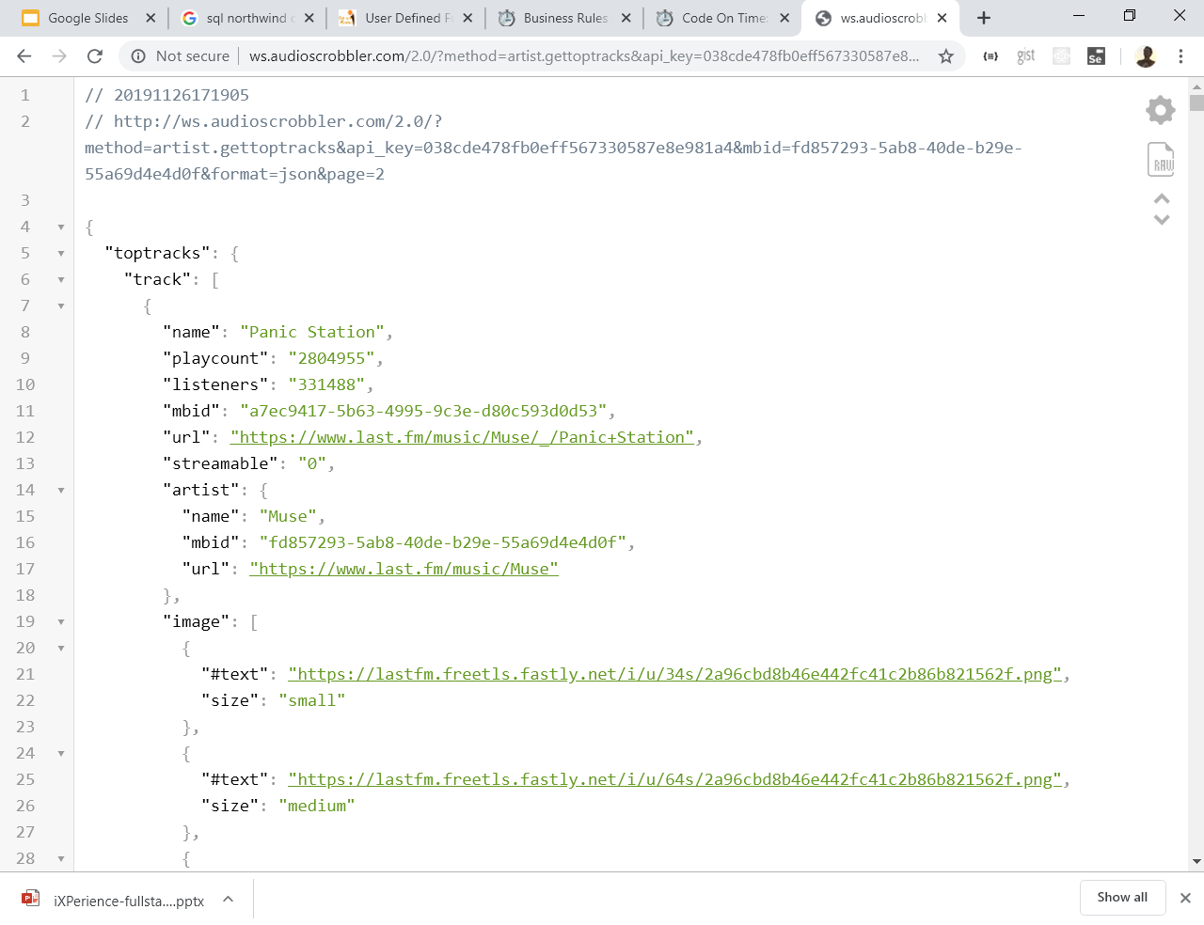
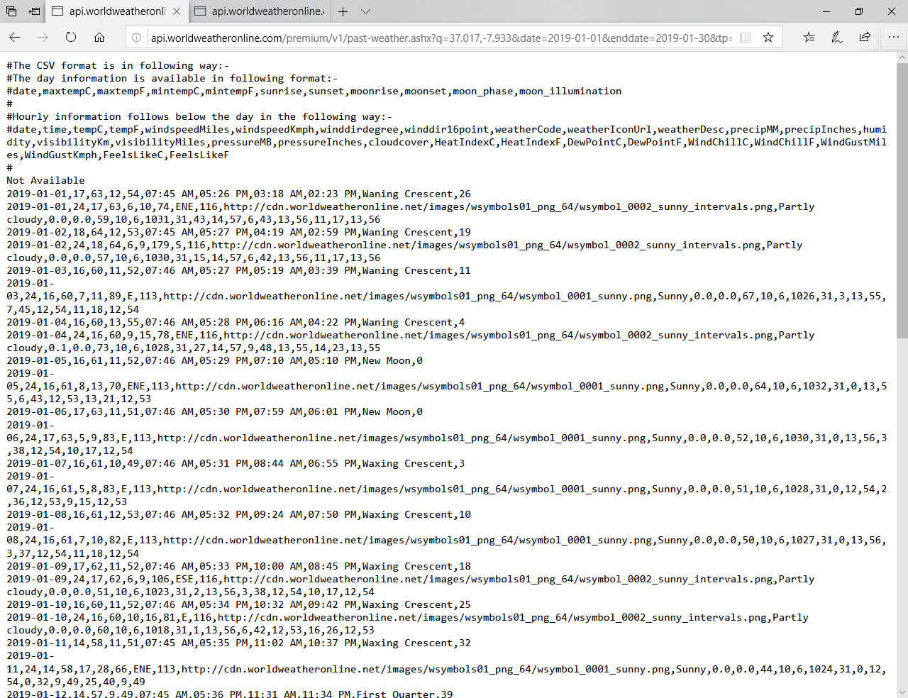
Different Kinds of Data
Notes:
Today applications can deal with different kind of data in different formats: XML, Data tables accessed with Sql, comma separated values and of course Json.

Slide 3
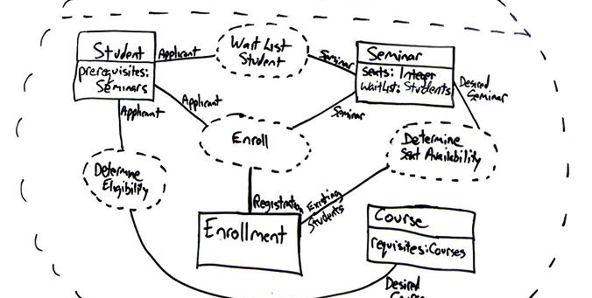
Domain Model
Notes:
Regardless the type of Data we want to deal with that data in a manner close to the programming model.
Usually as objects. And those objects play the role of the entities in the Domain Model.

Slide 4

Domain Model <-> Data Layer
UI
Domain Model
Data Access Layer
Notes:
Thus one of the most common application architectures is eternized in the three layers design.
Here the Data Access Layer gives an abstraction over the type of data.

Slide 5
Domain Model <-> Data Layer
UI
Domain Model
Data Access Layer
Web
DB
Data Sources
Files
Notes:
But DAL abstracts not only the data format but also the kind of source.
These data sources can provide data in any kind of format. We may have Web Services providing XML, and files storing CSV and document DB storing JSON.

Slide 6
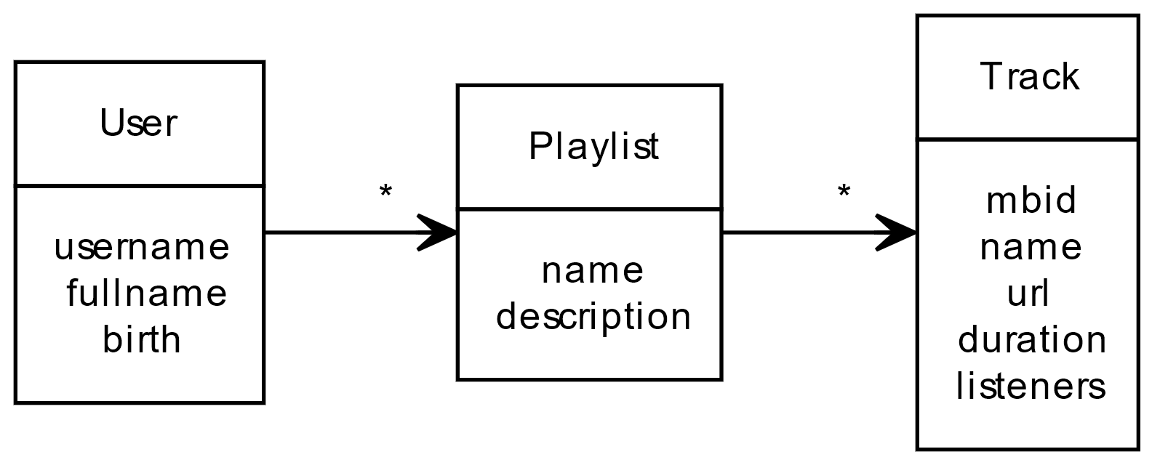
Use case: playlists
UI
Domain Model
Data Access Layer
Web
DB
Files
Notes:
Considering this use case for an application that managed playlist. A user may have many playlists and each playlist contains tracks.

Slide 7
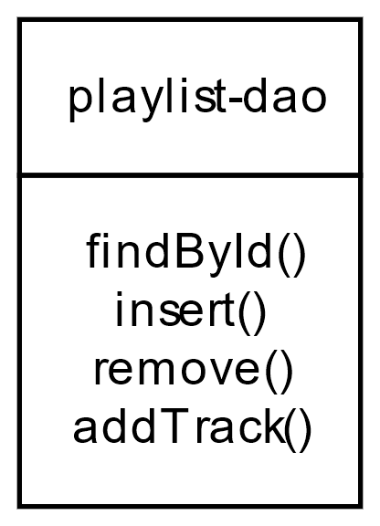
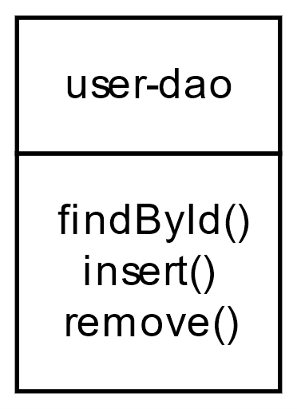
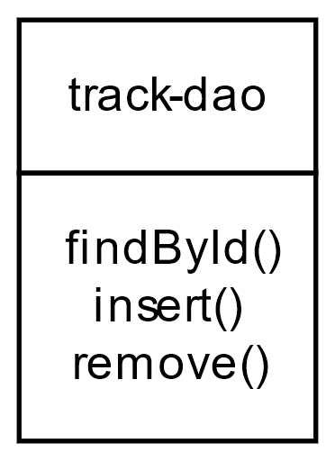
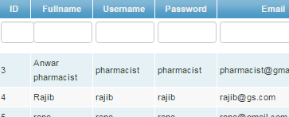
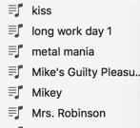
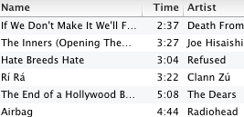
Use case: playlists
UI
Domain Model
Data Access Layer
Web
DB
Files
Notes:
To interact with the persistence storage, maybe a relational database or other, we may have a Data Access Objects, simply DAO that bridges the Domain Model with the database. We have one DAO per each Entity which has a corresponding Table.
But sometimes we may need to interact with more than one DAO to perform a single operation. E.g. Adding a track to a playlist.

Slide 8
Use case: playlists
UI
Domain Model
Data Access Layer

Slide 9
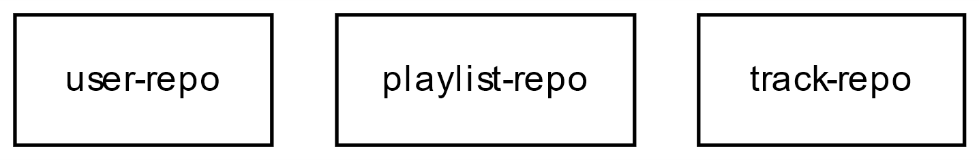
Use case: playlists
UI
Repositories:
Domain Model
Data Access Layer
Data Access Objects:

Slide 10
Repositories:
Data Access Objects:

Slide 11
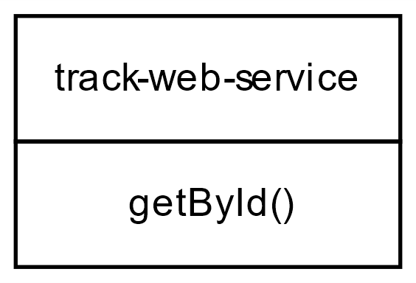
Repositories:
3
2
1
Data Access Objects:
a
a
b
b
c
Last.fm

Slide 12
playlist-repo: addTrack()… naïf
playlist-repo.js
export function addTrack(username, plstName, mbid, cb) {
/**
* 1. Checks for track with mbid in Dao.
* If it doesn't find the track in Dao then fetchs the track from the Web.
*/
tracksRepo.findById(mbid, (err, t) => {
if(err) return cb(err)
/**
* 2. Checks for the playlist and creates it if it doesn’t exist.
*/
findById(username, plstName, (err, playlist) => {
if(err) return cb(err)
/**
* 3. Insert track mbid in the playlist if both exist.
*/
dao.addTrack(username, plstName, mbid, cb)
})
})
}
Notes:
Here we have our first approach for addTrack implementation. A naif implementation.
It runs the tasks sequentially.

Slide 13
playlist-repo: addTrack()… concurrently
playlist-repo.js
export function addTrack(username, plstName, mbid, cb) {
let plst, track
const handler = err => {
if(err) return cb(err)
if(plst && track)
/**
* 3. Insert track mbid in the playlist if both exist.
*/
dao.addTrack(username, plstName, mbid, cb)
}
/**
* 1. Checks for track with mbid in Dao. If it doesn't find the track in Dao then fetch...
*/
tracksRepo.findById(mbid, (err, t) => { if(err) handler(err); else track = t; handler(null) })
/**
* 2. Checks for the playlist and creates if it does not exist.
*/
findById(username, plstName, (err, p) => { if(err) handler(err); else plst = p; handler(null)})
}
Notes:
To achieve a concurrent execution and without the support of any auxiliary library our code gets a little tricky.
Because first we write the handler corresponding to the 3rd task and then we call the 1st and 2nd tasks.
We may improve it through an auxiliary library like async.

Slide 14
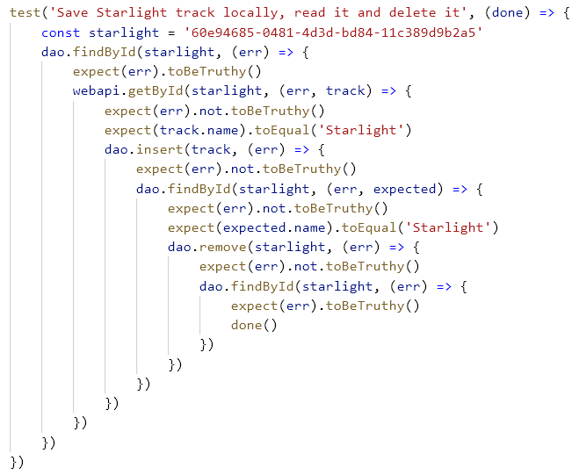
Callback Hell
Pyramid shape
Hard to read
Verbose
bug-prone, e.g. cb(data) rather than cb(null, data)
Hard to parallelize
Notes:
So programming with callbacks it is hard and the community call it the Callback Hell.

Slide 15
Callback Hell… yet…
“This is the most important topic to understand if you want to understand how to use node. Nearly everything in node uses callbacks. They weren't invented by node, they are just part of the JavaScript language.”
Max Odgen in Art of Node about Callbacks
Notes:
Yet callbacks is one of the most important topics in Node.js and Javascript. And we cannot ignore it.

Slide 16
Revisit playlists architecture
Domain Model Repository Data Access Objects
Notes:
So let’s revisit the architecture and see where callbacks come from.

Slide 17
Repositories:
3
2
1
Data Access Objects:
a
a
b
b
c
Last.fm
Notes:
Remembering the architecture of our application and focus again on the addTrack operation.

Slide 18
Last.fm
Files
Notes:
And now we consider an example where track-dao stores tracks in the filesystem.

Slide 19
Last.fm
Files
Notes:
If we use the node.js filesystem standard library then we must deal with callbacks.
And is that it is for all IO operations which provide an asynchronous API.

Slide 20
Callback pipeline
playlist-repo.js
export function addTrack(username, plstName, mbid, cb) {
...
tracksRepo.findById(mbid, (err, track) => { /* do something */ })
...
}
Last.fm
Files
tracks-repo.js
export function findById(mbid, cb) {
dao.findById(mbid, (err, track) => {
if(!err) return cb(null, track)
webapi.getById(mbid, (err, track) => {
if(err) return cb(err)
dao.insert(track, (err) => {
if(err) return cb(err)
cb(null, track)
...
tracks-dao.js
export function insert(track, cb) {
fs.writeFile(trackPath(track.mbid),JSON.stringify(track), cb)
}
Files
Notes:
Thus if we use the filesystem standard library of Node.js we must obey to the asynchronous idiom and provide a callback to receive the result of the operation.
When we are using an asynchronous idiom it propagates along the invocation stack.

Slide 21
ECMAScript 6 introduced Promises
Asynchronous idioms:
callbacks
Promises
async/await
suspend functions
Notes:
A Promise not an innovative concept form node.js.
Promises exist from 80s in languages such as Multilisp and others.

Slide 22
Callback <versus> Promise
callback: e.g.
Promise: e.g.
Represents the eventual result of an asynchronous operation
(err, data) => {…}
foo((err, data) => {...})
:Promise
then(data => … )
foo()
.then((data) => ...)
.catch(err => ...)
catch(err => … )

Slide 23
Callback <versus> Promise
export function insert(track, cb) {
const filename = trackPath(track.mbid)
fs.writeFile(filename, JSON.stringify(track), cb)
}
(err) => { ... }
succeed → cb(null)
failed → cb(error)
export function insert(track) {
const filename = trackPath(track.mbid)
return writeFile(filename, JSON.stringify(track))
}
:Promise
then(data => … )
catch(err => … )
succeed
failed

Slide 24
Promise API
playlist-repo.js
export function addTrack(username, plstName, mbid, cb) {
...
...
}
Last.fm
Files
tracks-repo.js
export function findById(mbid, cb) {
dao.findById(mbid, (err, track) => {
if(!err) return cb(null, track)
webapi.getById(mbid, (err, track) => {
if(err) return cb(err)
dao.insert(track, (err) => {
if(err) return cb(err)
cb(null, track)
...
dao.insert(track)
.then(() => cb(null, track))
.catch(err => cb(err))
tracks-dao.js
export function insert(track) {
return fs.writeFile(trackPath(track.mbid),JSON.stringify(track)
}
Files

Slide 25
Promise API: The power of composing
:Promise
:Promise
then(data => track )
then(track => … )
catch(err => … )
catch(err => … )
:Promise
:Promise
then(data => find(…) )
then(track => … )
catch(err => … )
catch(err => … )
export function find(…) {
return ... // returns a Promise of a Track
}

Slide 26
Promise API
playlist-repo.js
export function addTrack(username, plstName, mbid, cb) {
...
...
}
Last.fm
Files
tracks-repo.js
export function findById(mbid, cb) {
dao.findById(mbid, (err, track) => {
if(!err) return cb(null, track)
webapi.getById(mbid, (err, track) => {
if(err) return cb(err)
dao.insert(track, (err) => {
if(err) return cb(err)
cb(null, track)
...
return dao
.findById(mbid)
.catch(err => webapi
.getById(mbid)
.then(track => dao
.insert(track)
.then(() => track)
))
tracks-dao.js
export function insert(track) {
return fs.writeFile(trackPath(track.mbid),JSON.stringify(track)
}
Files

Slide 27
addTrack() now with Promises
playlist-repo.js
export function addTrack(username, plstName, mbid, cb) {
let plst, track
const handler = err => {
if(err) return cb(err)
if(plst && track)
/**
* 3. Insert track mbid in the playlist if both exist.
*/
dao.addTrack(username, plstName, mbid, cb)
}
/**
* 1. Checks for track with mbid in Dao. If it doesn't find the track in Dao then fetch...
*/
tracksRepo.findById(mbid, (err, t) => { if(err) handler(err); else track = t; handler(null) })
/**
* 2. Checks for the playlist and creates if it does not exist.
*/
findById(username, plstName, (err, p) => { if(err) handler(err); else plst = p; handler(null)})
}

Slide 28
addTrack() now with Promises
playlist-repo.js
export function addTrack(username, plstName, mbid, cb) {
let plst, track
const handler = err => {
if(err) return cb(err)
if(plst && track)
/**
* 3. Insert track mbid in the playlist if both exist.
*/
dao.addTrack(username, plstName, mbid, cb)
}
/**
* 1. Checks for track with mbid in Dao. If it doesn't find the track in Dao then fetch...
*/
tracksRepo.findById(mbid, (err, t) => { if(err) handler(err); else track = t; handler(null) })
/**
* 2. Checks for the playlist and creates if it does not exist.
*/
findById(username, plstName, (err, p) => { if(err) handler(err); else plst = p; handler(null)})
}

Slide 29
addTrack() now with Promises
playlist-repo.js
export function addTrack(username, plstName, mbid, cb) {
let plst, track
const handler = err => {
if(err) return cb(err)
if(plst && track)
/**
* 3. Insert track mbid in the playlist if both exist.
*/
dao.addTrack(username, plstName, mbid, cb)
}
/**
* 1. Checks for track with mbid in Dao. If it doesn't find the track in Dao then fetch...
*/
const ptrack = tracksRepo.findById(mbid)
/**
* 2. Checks for the playlist and creates if it does not exist.
*/
const pplst = findById(username, plstName)
}

Slide 30
addTrack() now with Promises
playlist-repo.js
export function addTrack(username, plstName, mbid, cb) {
/**
* 1. Checks for track with mbid in Dao. If it doesn't find the track in Dao then fetch...
*/
const ptrack = tracksRepo.findById(mbid)
/**
* 2. Checks for the playlist and creates if it does not exist.
*/
const pplst = findById(username, plstName)
/**
* 3. Insert track mbid in the playlist if both exist.
*/
...
dao.addTrack(username, plstName, mbid, cb)
}

Slide 31
addTrack() now with Promises
playlist-repo.js
export function addTrackSeq(username, plstName, mbid) {
/**
* 1. Checks for track with mbid in Dao. If it doesn't find the track in Dao then fetch...
*/
const ptrack = tracksRepo.findById(mbid)
/**
* 2. Checks for the playlist and creates if it does not exist.
*/
const pplst = findById(username, plstName)
/**
* 3. Insert track mbid in the playlist if both exist.
*/
return ptrack
.then(track => pplst)
.then(plst => dao.addTrack(username, plstName, mbid))
}

Slide 32
With Promises
Pyramid shape
Hard to read
Verbose
bug-prone, e.g. cb(data) rather than cb(null, data)
Hard to parallelize
Notes:
So programming with callbacks it is hard and the community call it the Callback Hell.

Slide 33

Next… Overview
async/await Promise.all() Asynchronous Domain Model

Slide 34
Overview…
With async/await
Like synchronous calls but without blocking
tracks-repo.js
tracks-repo.js
return dao
.findById(mbid)
.catch(err => webapi
.getById(mbid)
.then(track => dao
.insert(track)
.then(() => track)
))
try {
return dao.findById(mbid)
}
catch (err) {
const track = await webapi.getById(mbid)
await dao.insert(track)
return track
}

Slide 35
Overview…
playlist-repo.js
export function getTracks(username, plstName, cb) {
dao.getTracks(username, plstName, (err, arr) => {
if (err) return cb(err)
const res = []
arr = arr.filter(mbid => mbid != '')
arr.forEach(mbid => {
tracks
.findById(mbid)
.then(t => {
res.push(t)
if (res.length >= arr.length)
cb(null, res)
})
.catch(err => cb(err))
})
})
}
Promise.all()
playlist-repo.js
export function getTracks(username, plstName) {
return dao
.getTracks(username, plstName) // Promise<Array<String>>
.then(arr => arr // Promise<Array<Promise<Track>>>
.filter(mbid => mbid != '')
.map(tracks.findById))
.then(arr => Promise.all(arr)) // Promise<Array<Track>>
}

Slide 36
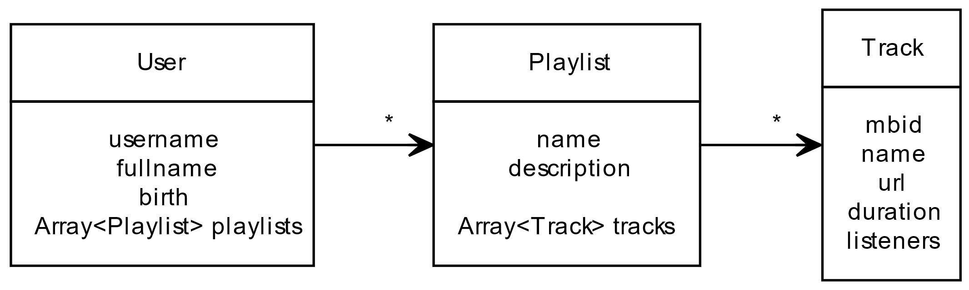
Association
e.g. A user has playlists and a playlist has tracks.
Association: “has” relationship
Notes:
In some contexts and in Domain Driven Design we like to model our entities relating them through associations.

Slide 37
Eager
The use of Array turns the relatioship eager.
Notes:
Loading a User requires loading all its playlists which in turn loads their tracks.
Even if we are only interested in the user information of playlist data the entire graph will be loaded.

Slide 38
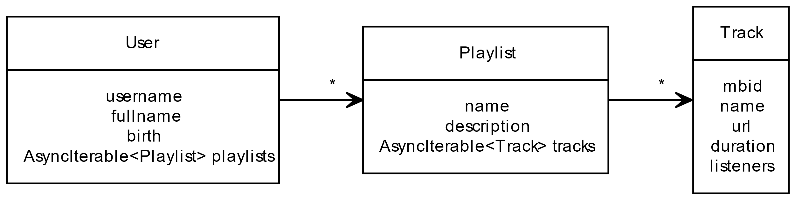
Asynchronous
Do not wait for relationship completion
ECMAScript 9 introduces asynchronous iteration via the AsyncIterator protocol and async generators.
Notes:
Use Asynchronous Iterables

Slide 39
Overview…
With async iterator
playlist-repo.js
/**
* @returns {Promise<Track[]>}
*/
export function getTracks(username, plstName) {
return dao
.getTracks(username, plstName)
.then(arr => arr
.filter(mbid => mbid != '')
.map(mbid => tracks.findById(mbid)))
.then(arr => Promise.all(arr))
}
Like synchronous calls but without blocking
playlist-repo.js
/**
* @async
* @yields {Track}
*/
export async function* getTracks(username, plstName) {
for await (const mbid of dao.getTracks(username, plstName)) {
if(mbid != '') {
yield tracks.findById(mbid)
}
}
}

